Slide 1
Lamp control with smartphone
Cappadokia, 2022
Creators : Aikozy Asel

Slide 2
Aims of project work: Define the ways to turn on the light and fan by voice using a smartphone, saves time and gives a comfortable mood.
Creators : Aikozy Asel
Theme of project work: Lamp control with smartphone

Slide 3
Necessary tools and materials
1
Fan
2
Arduino microcontroller
Power bank
3
Bluetooth module of HC-06 device
Lamp

Slide 4
When we say “turn on the fan” with our voice, the fan is spinning. And if you say to your smartphone “turn off the fan” with your voice, the fan will stop rotating. There is a built-in light bulb, to turn on this lamp we say the word "light" to the smartphone with our voice, then the light will turn on, if we say "turn off the light" the light will turn off by itself.
Project Progress

Slide 5
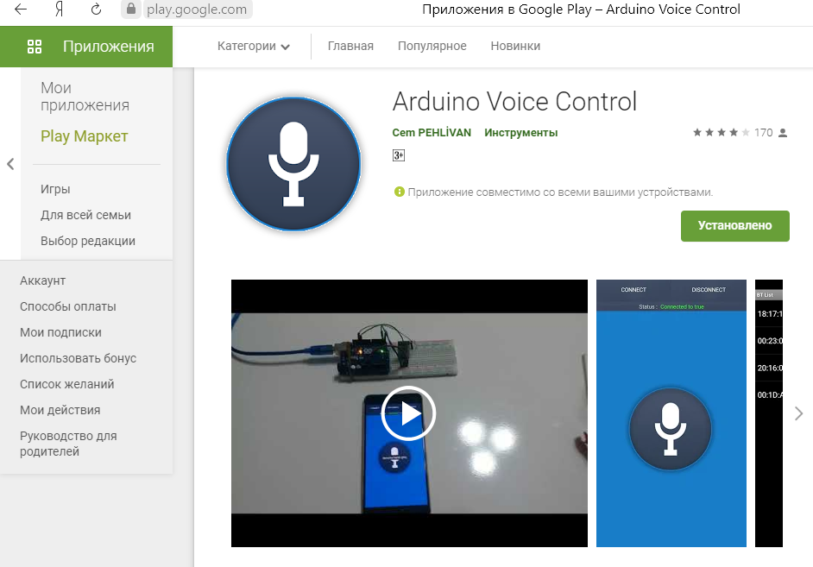
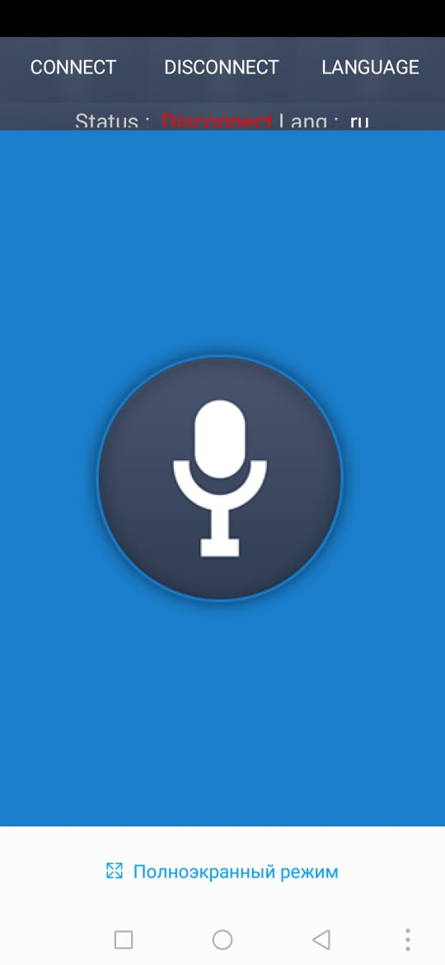

Slide 6
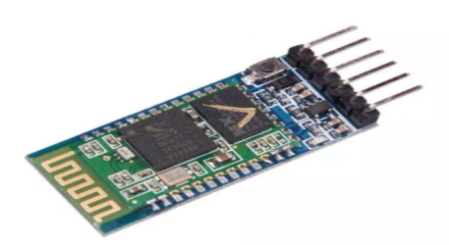
Project Progress
We control the light and fan by voice using a smartphone. Here we will use arduino parts and create a series of programs. If we take the fan here, it works with 5 volts of power. As it spins, it shows the time with colored lights.
An arduino microcontroller is installed, our bluetooth module HC-06 is connected to it,

Slide 7
Progress of project work
As for the voice control interface, we will download the "Arduino Voice Control" application from the play store for free. Let's install
and run
You can control the light from your smartphone.

Slide 8
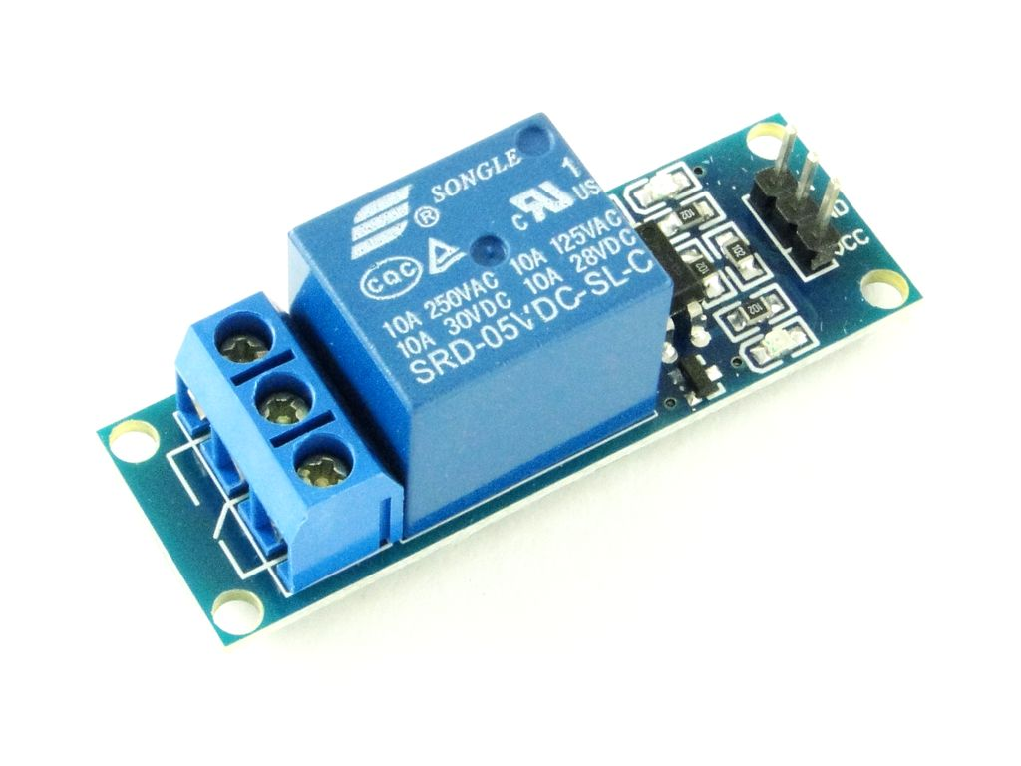
Bluetooth module transmits signal over the air

Slide 10
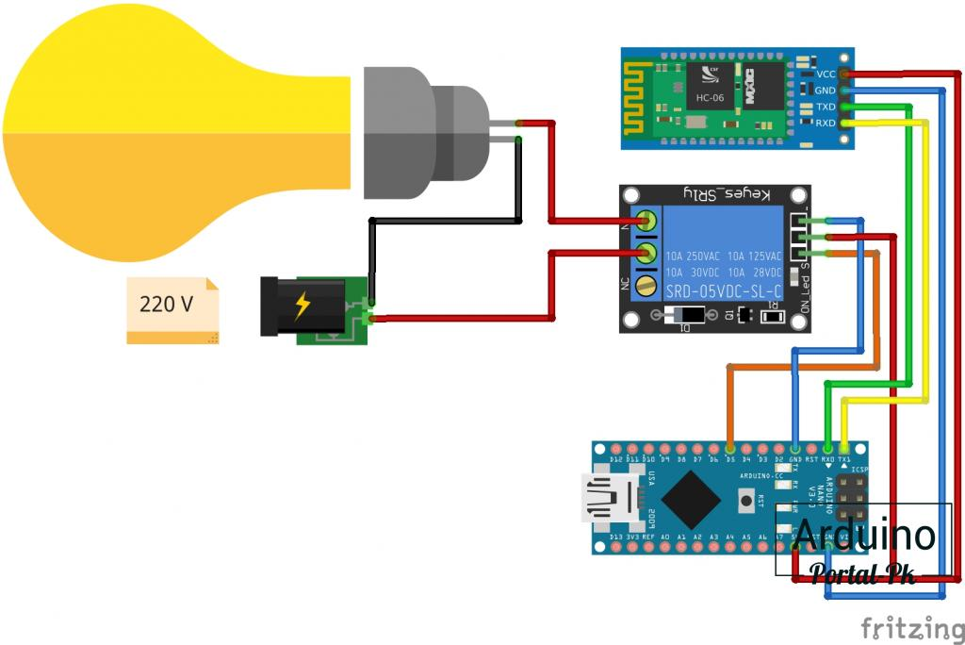

Slide 11
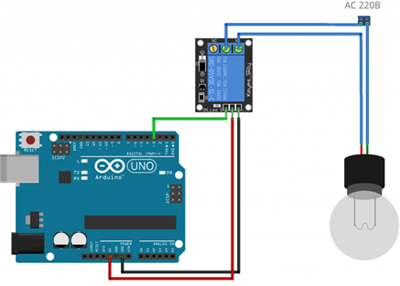
The circuit itself is very simple, its basis is the Arduino microcontroller, which processes the signal from the sensor, performs the necessary action through the executable part. His choices are focal and modular. It best corresponds to the concept of "smart home", which allows you to expand its capabilities through virtually unlimited external modules, a convenient programming system and an interface with a computer.

